Slide 1
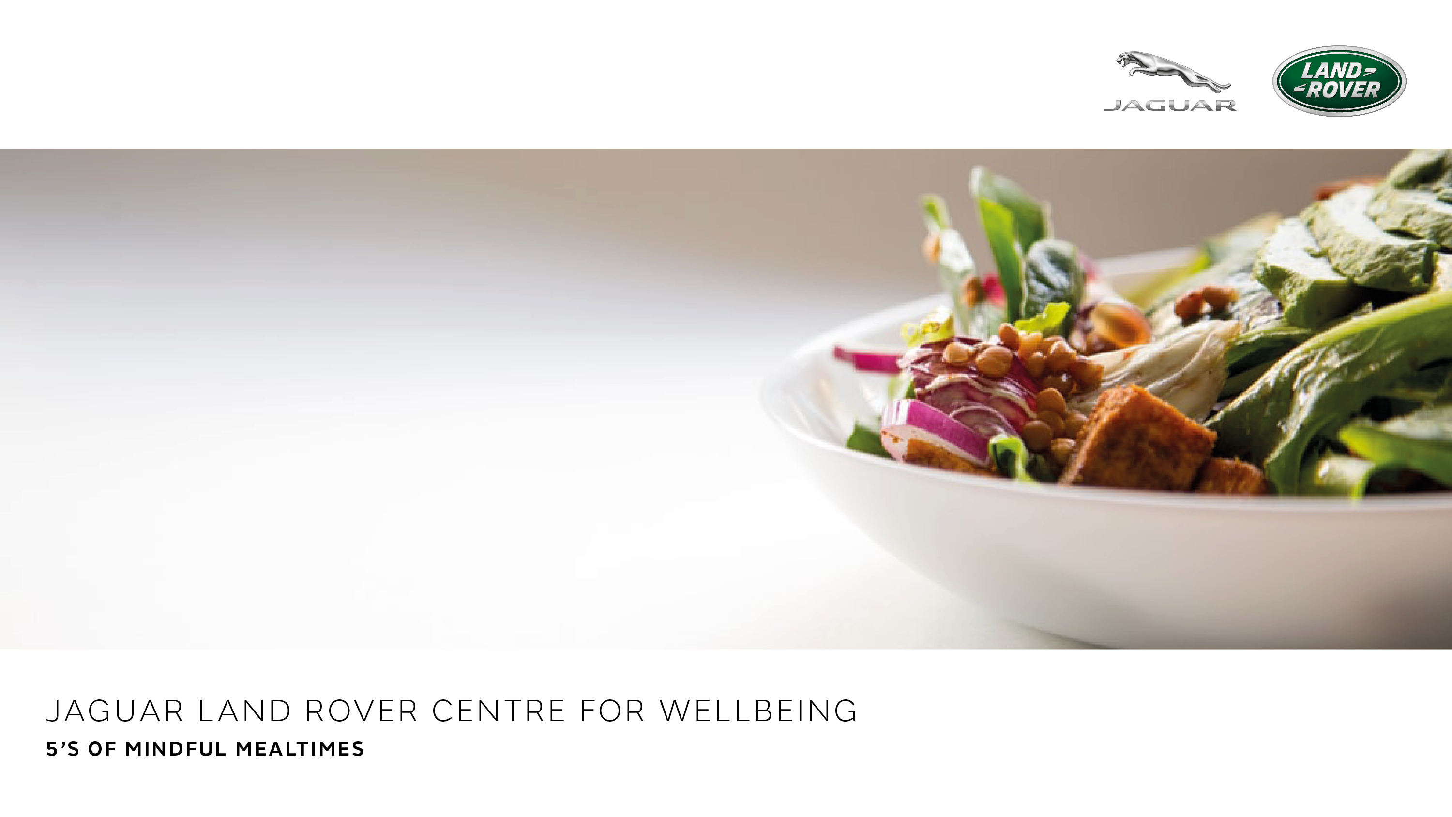


Slide 2
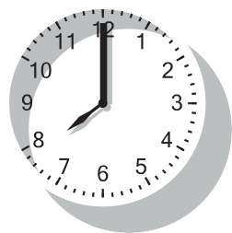
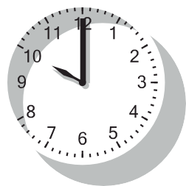
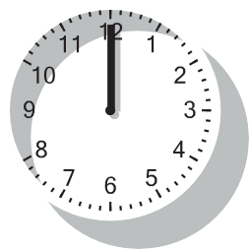
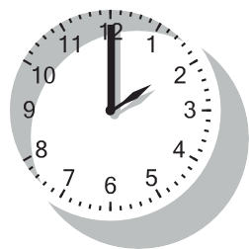
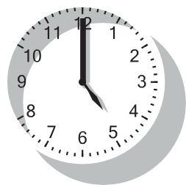

S - SCHEDULE
1
Having regular meal times:
Helps gives structure to the day
BREAKFAST
MORNING SNACK
LUNCH
Stops others asking when they’re going to get fed!
Helps us and others to plan around meal times
Reduces the temptation to snack and graze
Avoids leaving long gaps between eating and becoming over hungry
AFTERNOON SNACK
DINNER

Slide 3




S - SWITCH OFF
2
After meal preparation has finished, switch off any phones, laptops, TVs
Distractions will detract from your enjoyment of our food
Bad news may make have a negative impact on our mood which affects our body’s ability to digest our food

Slide 4
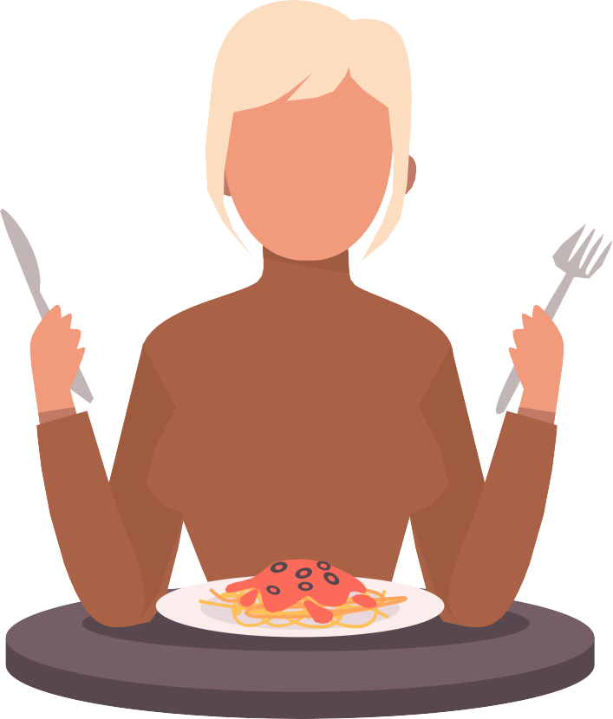
S - SIT
3
Ideally we should sit down whilst eating a meal
It helps us relax, take our time and more easily digest our food
A rushed meal can lead to symptoms of indigestion, over-eating and weight gain

Slide 5











S - SOCIALISE
4
If possible, eat around a communal table with those you live with
Relaxes the body
Improves digestion
Why a Meditteranean Style Diet is so healthy, because it’s usually based around the importance of eating
together

Slide 6
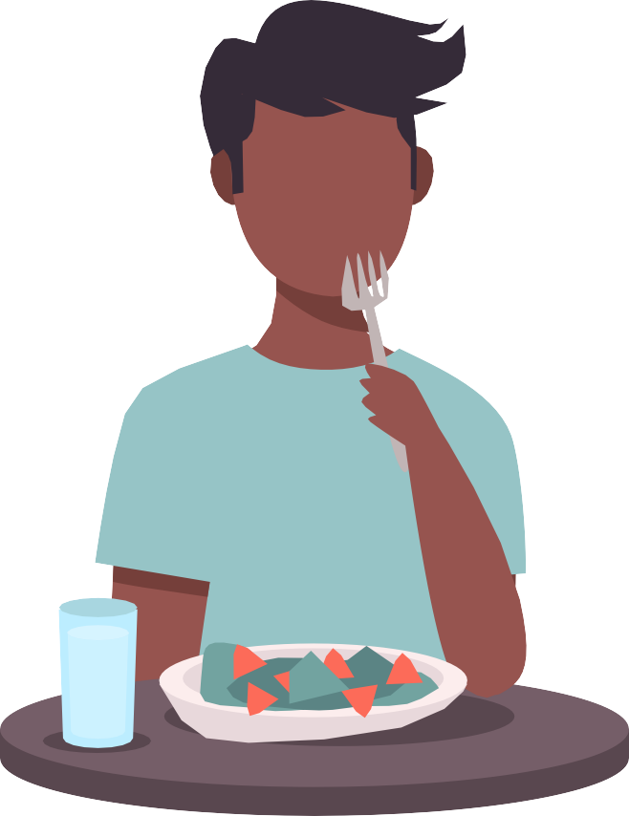
S - SATISFY
5
Means eating until we are around 80% full / comfortably full
Check portion sizes are enough
Not too much
Not too little
Stops subsequent snacking, cravings and evening grazing

