Slide 1
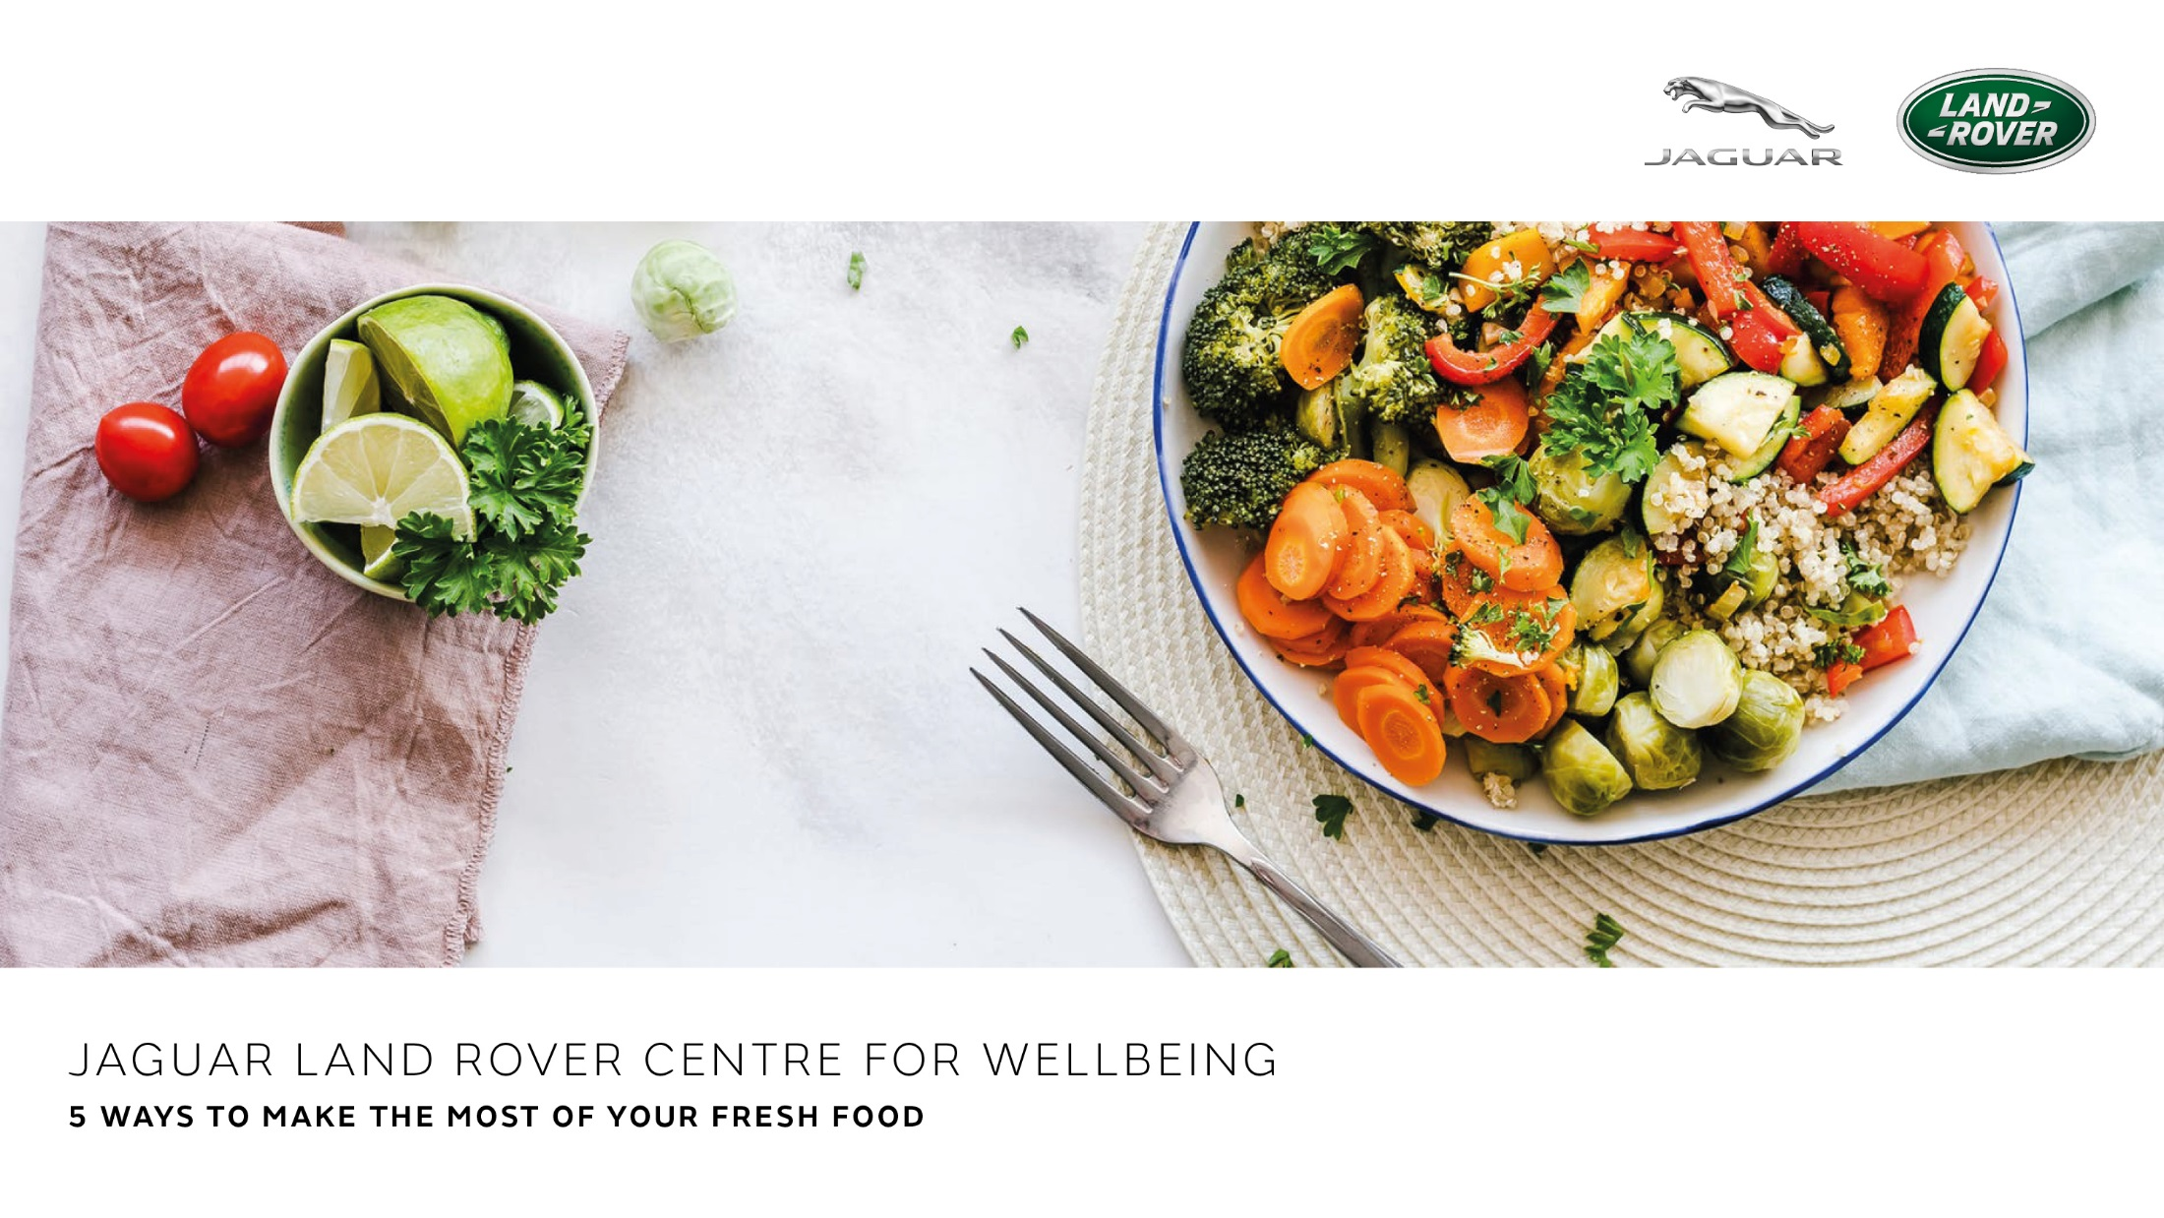
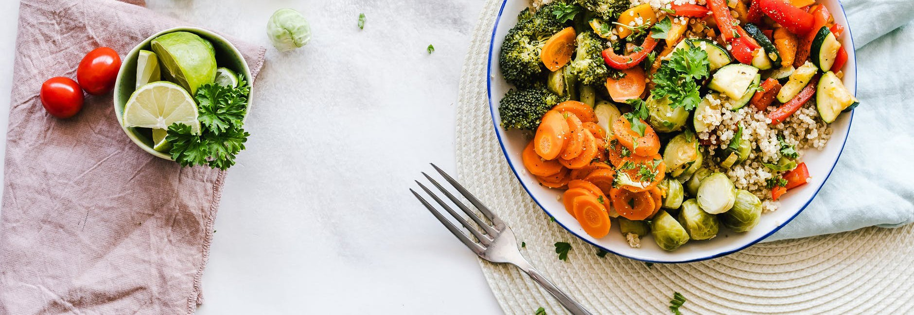

JAGUAR LAND ROVER CENTRE FOR WELLBEING
5 WAYS TO MAKE THE MOST OF YOUR FRESH FOOD

Slide 2
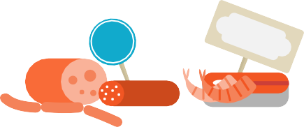


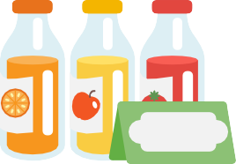
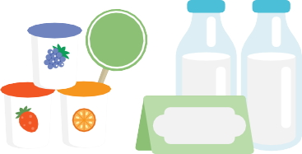

ARRANGE IN DATE ORDER
1
₅TH
Gives a quick and visual guide as to what to use first
1
ST
₃RD
Encourage those who live with you do to use the oldest first and newest last
Fresh food usually has a “Use by” or “Consume By”
date on the label and is a useful guide to help to keep things in order
“Best Before” dates usually have more flexibility on when they need to be used by
TH
9
9
8
TH
TH
15
TH
₁₁TH
₁₄TH
27
TH
TH
29
₃₀TH

Slide 3

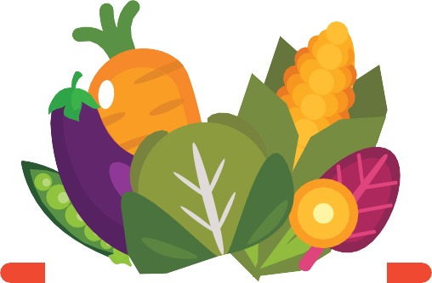
FOOD APPROACHING ITS “USE BY” DATE
2
Think of some recipes which can use up anything which is going out of date and then freeze what you have cooked.
Extra tomatoes and peppers into a ratatouille
Extra greens and root veg into a soup
Extra berries or fruit into a smoothie
Extra meat into casseroles or curries

Slide 4
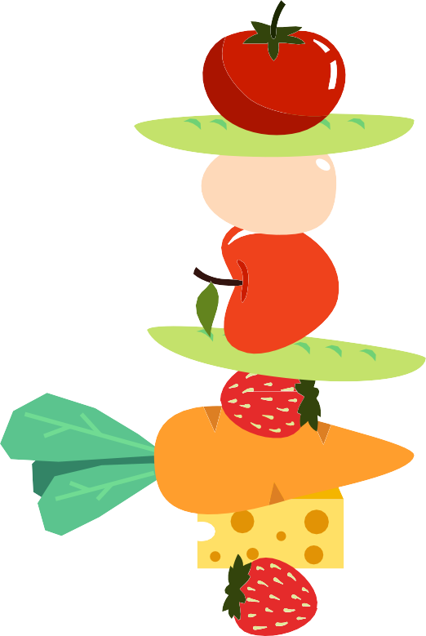
FRESH FOOD FOR SNACKING
3
Fresh finger food makes a good substitute for processed snacks. Great for grazers
Chopped up carrots
Fruit
Cheese sticks
Boiled eggs
Grapes
Baby tomatoes

Slide 5
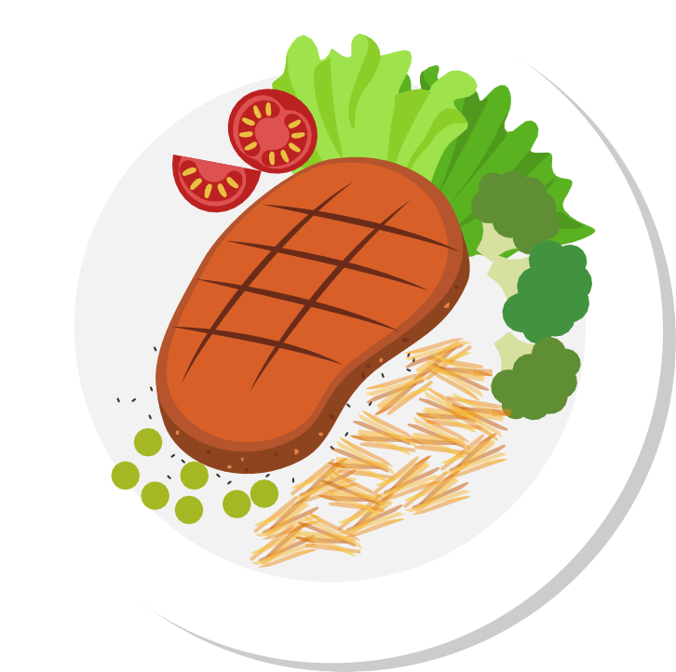
PLAN MEALS AROUND FRESH FOOD
4
Plan meals around food which you have available
Base a meal around a healthy protein (meat, fish, pulses) and complement it with fresh
salad or vegetables and a portion of healthy carbohydrates
Choose high fibre, whole grain versions of carbohydrates if possible – e.g. brown rice or brown pasta

Slide 6
PREPARE AHEAD
5
Especially useful if you are short of time
Useful to keep pre prepared food ready in the fridge
Examples include a big bowl of preprepared salad, pre chopped vegetables – usually lasts a good few days in the fridge in a sealed container
Makes meal times easier and less time consuming

